Slide 1
Chapter 3: Source code generation from UML models
Bahir Dar Institute of Technology
Faculty of Computing
Course Name: Software Tools and practice
Target group:3rd year software engineering students
Compiled by Samuel.A

Slide 2
Source code generation from UML models
Source code generation is the process of creating programming code from a UML model.
There are great benefits in taking this approach as the source code Packages, Classes and Interfaces are automatically created and elaborated with variables and methods.

Slide 3
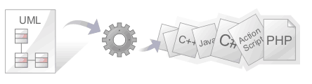
Source code generation from UML models

Slide 4
Source code generation from UML models
Enterprise Architect can also generate code from a number of behavioral models, including StateMachine, Sequence and Activity diagrams.
There is a highly flexible template mechanism that allows the engineer to completely tailor the way that source code is generated, including the comment headers in methods and the Collection Classes that are used.

Slide 5
Source code generation from UML models
From an engineering and quality perspective, the most compelling advantage of this approach is that the UML models and therefore the architecture and design are synchronized with the programming code.
An unbroken traceable path can be created from the goals, business drivers and the stakeholder’s requirements right through to methods in the programming code.

Slide 6
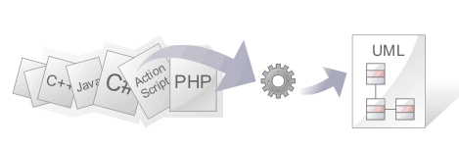
Importing Source Code

Slide 7
Importing Source Code
The ability to view programming code and the models it is derived from at the same time brings clarity to the design of a system.
One of Enterprise Architect's powerful code engineering features is the ability to Reverse Engineer source code into a UML model.

Slide 8
Importing Source Code
A wide range of programming languages are supported and there are options that govern how the models are generated. Once the code is in the model it is possible to keep it synchronized with the model regardless of whether the changes were made directly in the code or the model itself.
The code structures are mapped into their UML representations; for example, a Java class is mapped into a UML Class element, variables are defined as attributes, methods modeled as operations, and interactions between the Java classes represented by the appropriate connectors.

Slide 9
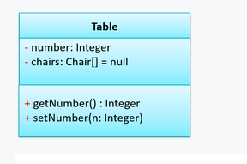
Importing Source Code

Slide 10
Importing Source Code
class Table {
private Integer number;
private Chair[] chairs = null;
public Integer getNumber() {
//...
}
public void setNumber(Integer n) {
//...
}
}

Slide 11
Importing Source Code
The representation of the programming code as model constructs helps you to gain a better understanding of the structure of the code and how it implements the design, architecture and the requirements, and ultimately how it delivers the business value.

Slide 12
Importing Source Code
It is important to note that if a system is not well designed, simply importing the source into Enterprise Architect does not turn it into an easily understandable UML model.
When working with a poorly designed system it is useful to assess the code in manageable units by examining the individual model Packages or elements generated from the code; for example, dragging a specific Class of interest onto a diagram and then using the 'Insert Related Elements' option at one level to determine the immediate relationships between that Class and other Classes.
From this point it is possible to create Use Cases that identify the interaction between the source code Classes, providing an overview of the application's operation.

Slide 13
UML Review – class diagrams

Slide 14
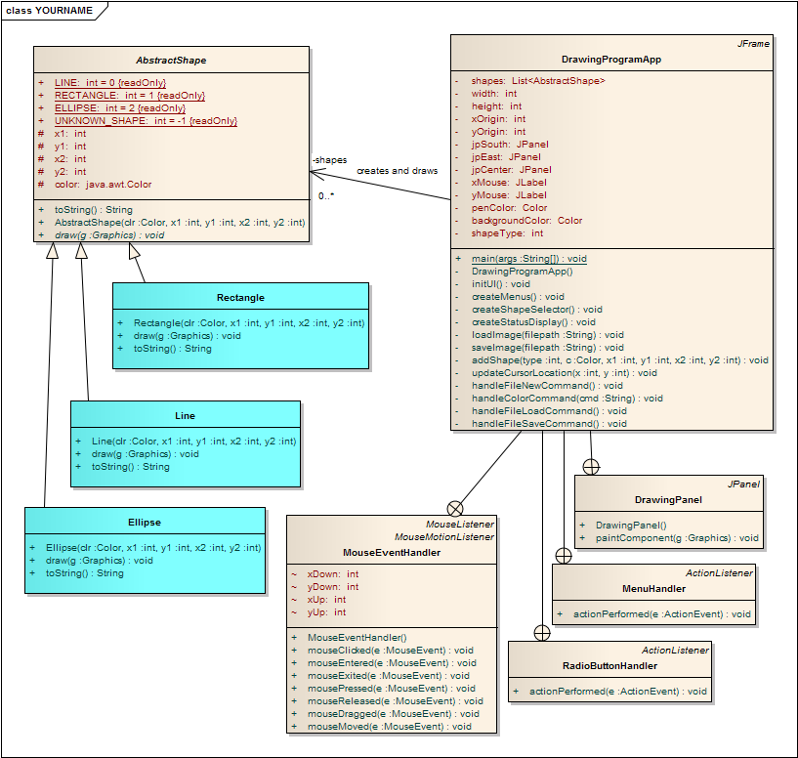
Remember UML Diagrams from SE1021 or CS2852?
What does a Class diagram illustrate?

Slide 15
UML Review: Class diagrams
A UML Class Diagram represents classes and their relationships to one another
UML is not specific to Java, so a Class Diagram really represents the generic concept of a class without regard to what language implements the actual class
The name of the class always appears at the top of a Class Diagram rectangle:
UML equivalent (Java) code
Account
public class Account
{
}

Slide 16
Class diagrams: Attributes
A Class Diagram can also show class attributes or fields
Syntax: [visibility] <attr_name> [ : <type> [=default_value] ]
Note: The static specification may be illustrated with an underscore or with italics
public class Account
{ private double balance;
public static double rate = 2.5;
}
Account
balance: double
+ rate: double = 2.5
What if balance is declared as with protected visibility?
How about package visibility?

Slide 17
Class diagrams: Operations
A Class Diagram can also show class methods or operations
UML Syntax: [visibility] <name>([ [in|out] param:type]*] [:<return_type>]
public class Account
{ private double balance;
public static double rate = 2.5;
public void deposit (double amount) {
balance += amount;
}
/*package*/ double getBalance() {
return balance;
}
public static void setRate( double intRate ) {
rate = intRate;
}
}
Account
balance: double
+ rate: double= 2.5
+ deposit(amount : double) : void
~ getBalance() : double
+ setRate(intRate: double) : void
Methods can also have protected or package visibility.
What is [in|out] about?

Slide 18
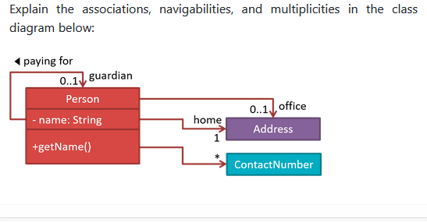
Exercise

Slide 19
Repeat: UML Class Diagrams typically illustrate some type of relationship between classes
The easiest to master are those that illustrate a permanent (that is, static) relationship between classes
There are two basic categories of static relationships:
Inheritance (2 forms of this)
Dependency

Slide 20
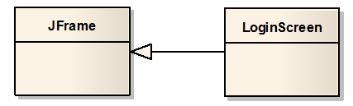
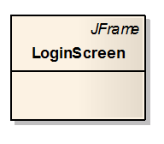
Generalization is a form of inheritance that indicates that a class (LoginScreen) inherits behavior defined and implemented in another class (JFrame) We also say: LoginScreen is a subclass of JFrame
The connector is a solid line pointing to the class whose behavior is being inherited with a triangle (not an arrow!)
The connector “points” from the subclass to the parent class.
Reducing clutter: Generalization can be illustrated in the alternate notation shown if the parent class is not present in the class diagram

Slide 21
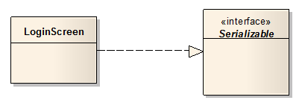

Realization is also a form of Inheritance that indicates that a class implements the behavior defined in an interface
Here, the LoginScreen implements the behavior of the Serializable interface.
The connector is a dashed line pointing to the class whose behavior is being implemented with a triangle (not an arrow!)
Realization can also be illustrated in the alternate notation shown if the parent class is not present in the class diagram

Slide 22


Class diagrams sometimes explicitly illustrate Dependency relationships of classes on other classes (or packages)
Dependency is indicated by a dashed-line connector, with the line originating from the dependent class and pointing (with an arrow) at the other class it depends upon.
The arrow may also point at a package (e.g. javax.swing), implying a dependency on many of the classes within that package.

Slide 23
There are additional relationships between classes that are not necessarily permanent – meaning they can change during program execution.
Dynamic relationships between instances of classes (that is, between objects), or between classes and objects (if a class is non-instantiable, as in a static class) are:
Association
Aggregation (2 forms of this)

Slide 24
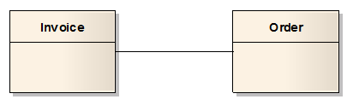
The Association connector is used to indicate a run-time (dynamic) interaction between instances of classes
The single-line connector doesn’t indicate anything specific – that is, it’s an unspecified association. About all we can say is that objects of these classes somehow interact when the application executes – perhaps an Invoice somehow accesses an Order (or vice versa).
In fact, the Invoice can create the Order at runtime (and later delete it); or the Order can create the Invoice at runtime – thus these relationships are dynamic.
We may not know enough to be more specific when we’re designing our application – it may have to wait until we get into implementation

Slide 25
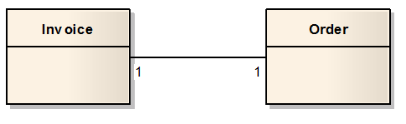
An Association can indicate multiplicity – that is, how many objects of one class interact with objects of the other
This Association indicates that there is a one-to-one correspondence between Invoice instances and Order instances; that is, for every Invoice object, there is one corresponding Order object, and vice versa.
If the numbers are absent, you can assume that there is a one-to-one correspondence.

Slide 26
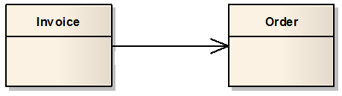
Associations can indicate navigability – that is, whether an object holds a reference to the other
This one-way directed association indicates that an Invoice object holds a reference to a single Order object, but the Order does not hold a reference to an Invoice.
Note that we’ve omitted the multiplicity here, so it’s assumed to be one-to one

Slide 27
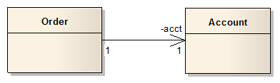
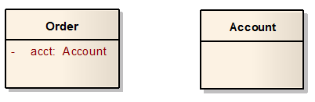
End Roles indicate that an association is maintained via a specific attribute defined within a class
This one-to-one, one-way association with end role acct indicates that an Order object holds a reference to a single Account object via a private Account attribute named acct.
Note that we’ve included the multiplicity here, but we could have omitted them since the correspondence is one-to-one
Here is another way of showing the same relationship.
Is this more or less illustrative?

Slide 28
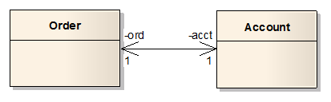
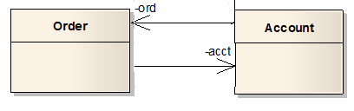
Bi-directional navigability
This bi-directional association indicates that an Order object holds a reference to a single Account object via a private Account attribute named acct, and that an Account object holds a reference to a single Order object via a private Order attribute named ord.
However, it is always best to avoid bi-directional associations, and instead to use two uni-directional arrows to illustrate this relationship.
Note that we’ve omitted the multiplicity here, so it’s assumed to be one-to one.
It also reduces clutter.

Slide 29

An Association can be labeled to indicate the nature of the relationship
This diagram can be read as follows: “A Person lives in a House, which the Person refers to as home”.
Again, we’ve omitted the multiplicity here, so it’s assumed to be one-to one.
It also reduces clutter.

Slide 30
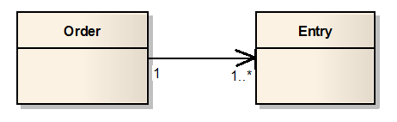
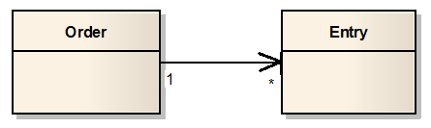
Associations can indicate various degrees of multiplicity
This Association indicates that for every Order object, there is at least one corresponding Entry object.
Here, any number (including zero) of Entry objects correspond to each Order object
We can omit the 1 next to the Order class to reduce clutter

Slide 31
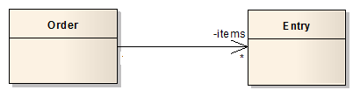
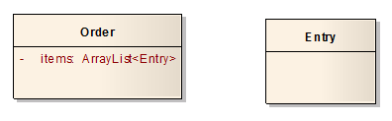
Associations with multiplicity >1 implies that a reference is a collection of objects
This one-way association indicates that an Order object holds a reference to a collection of zero or more Entry objects via a private attribute named items.
However, the type of collection is not specified here.
The same association, where the collection is explicit. However, this approach is not preferred.

Slide 32
Good UML Class Diagram practices
Consider the following code:
public class Student {
private String firstname;
private String lastname;
private Date birthdate;
private String major;
private int id;
private double gpa;
private List<Course> courses;
}
What does the UML class diagram look like?
Which class(es) should be explicitly shown? Why?
Which class(es) should appear as attributes? Why?

Slide 33
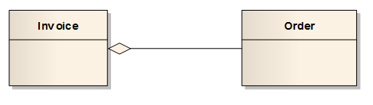
Advanced Associations: Containment (aka Shared Aggregation) is a form of an association that indicates a whole-part relationship.
Containment indicates that an Invoice is logically comprised of an Order part (one, in this case). It does not make sense for Invoice object to exist independently of the Order object, because an Invoice always must contain an Order.
However, the Order can exist without the Invoice. That is, if the Invoice object is deleted, the Order can still exist (maybe it can be fulfilled free of charge).
Some believe that it is not necessary to indicate Containment/Shared Aggregation, and that more general directed Association is sufficient.

Slide 34
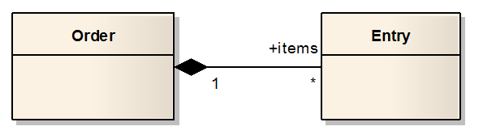
Another Advanced Association: Composition (or Composite Aggregation) is a stronger form of aggregation that implies a whole-part relationship and lifetime of the parts
Composition implies that an Order is comprised of Entry parts (an Order logically does not exist without any Entry objects), and that the Entry objects cannot exist independently of the Order object; that is, the Order exclusively owns the Entry objects.
The lifetime of the Entry objects is controlled by the Order object. If the Order is deleted, all the Entries are deleted as well.
Again, some believe that it is not necessary to indicate Compostion/Composite Aggregation, and that more general directed Association is sufficient.

Slide 35
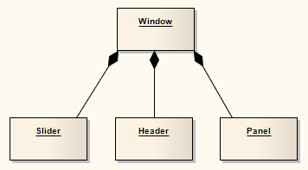
If a Composition is deleted, all of its parts are deleted with it
A component (part instance) can be included in a maximum of one Composition at a time.
A part can be individually removed from a Composition without having to delete the entire Composition.

Slide 36
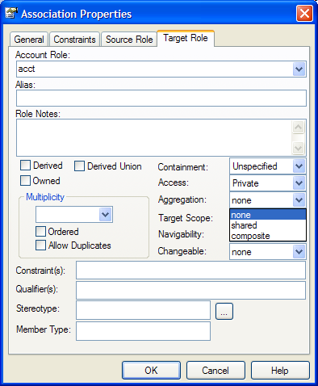
Inconsistent terminology between strict UML and EA
UML Containment
A is composed of B; B can exist without A
EA refers to this as Shared Aggregation
UML Composition
A is composed of B; B cannot exist without A
EA refers to this as Composite Aggregation

Slide 37

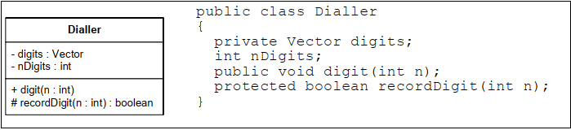
Different types of Relationships
The class named Dialler is represented as a simple rectangle.

Slide 38
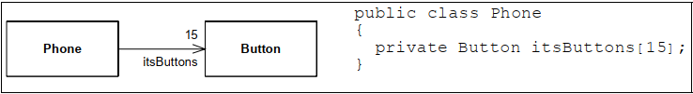
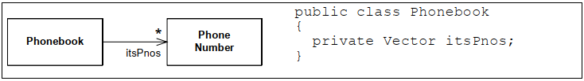
Association Relationships
Associations between classes most often represent instance variables that hold references to other objects.
Multiplicity-The number near the arrowhead represents the number of objects that connected to the other associate.
A Phonebook is connected to many PhoneNumber objects. The star means many. In Java this is most commonly implemented with a Vector, a List, or some other container type.

Slide 39
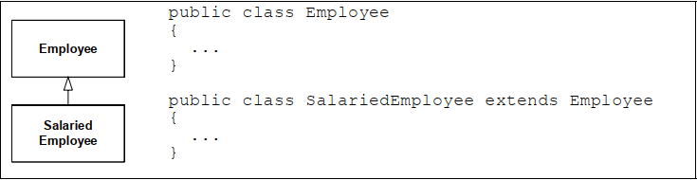
Inheritance Relationships
Supper and sub class relationships.

Slide 40
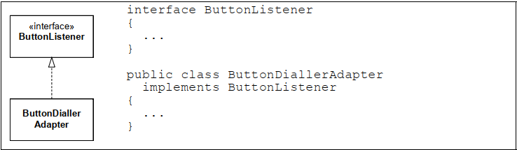
Realization Relationships
UML has a special notation for the kind of inheritance used between a Java class and a Java interface.

Slide 41
Example
As an example we will develop a small Java application comprises three files: Building.java, Owner.java and Main.java. Main is a small program that creates instances of buildings and owners and associates them by creating the appropriate links

Slide 42
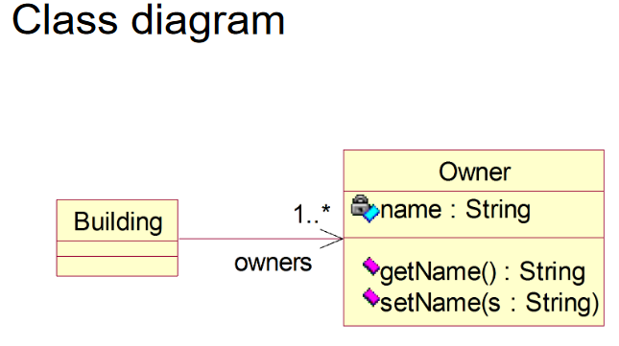
Example

Slide 43
Example
A possible implementation of the Building class
import java.util.*; public class Building { private Vector owners; public Building() {
owners=new Vector();
} public Enumeration getOwners() { return owners.elements(); } public void addOwner(Owner c) { owners.addElement(c); } }

Slide 44
Example
the Owner class public class Owner { private String name; Owner() {} public void setName(String n) { name = n; } public String getName() { return name; } }

Slide 45
Example
the Owner class public class Owner { private String name; Owner() {} public void setName(String n) { name = n; } public String getName() { return name; } }

Slide 46
Example
Usage example (1) public static void main(String[] args) { Owner o1 = new Owner(); Owner o2 = new Owner(); Owner o3 = new Owner(); o1.setName("GIWRGOS"); o2.setName("NIKOS"); o3.setName("FANH");

Slide 47
Example
//b1 is owned by o1 and o2 Building b1 = new Building(); b1.addOwner(o1); b1.addOwner(o2); //b2 is owned by o1 and o3 Building b2 = new Building(); b2.addOwner(o1); b2.addOwner(o3);

Slide 48
Example
Usage example (3) Enumeration e; System.out.println( "The owners of the first building"); e=b1.getOwners(); while (e.hasMoreElements()) { Owner o = (Owner) e.nextElement(); System.out.println("\t"+o.getName()); } System.out.println( "The owners of the second building"); e=b2.getOwners(); while (e.hasMoreElements()) { Owner o = (Owner) e.nextElement(); System.out.println("\t"+o.getName()); } }

Slide 49
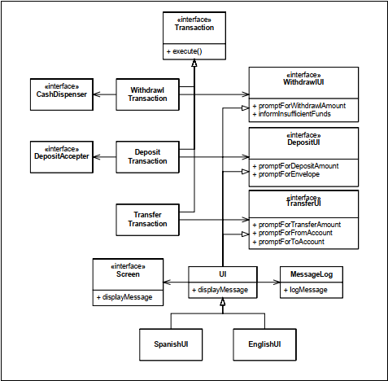
Class Work
Generate Source code from the class diagram below

Slide 50
Class Work
a. Draw a class diagram to represent the following code. interface Player {
public void challenge();
}
interface Trainable {
public void train();
}
abstract class Bot implements Player {
}

Slide 51
Class Work
class TrainableBot extends Bot implements Trainable {
@Override
public void challenge() {
}
@Override
public void train() {
}
}
class Human implements Player {
@Override
public void challenge() {
}
}

Slide 52
Class Work
(b) Add these association classes to the diagram:
i. A Player object can challenge another Player object. The Challenge class keeps track of the association between the two Player objects: the challenger and the target of the challenge.
ii. A Human object can train a SmartBot object. The Lesson class keeps track of that association.
(c) Convert the two association classes to normal classes.

